Slide 1
Oracle vs MS SQL comparison

Slide 2
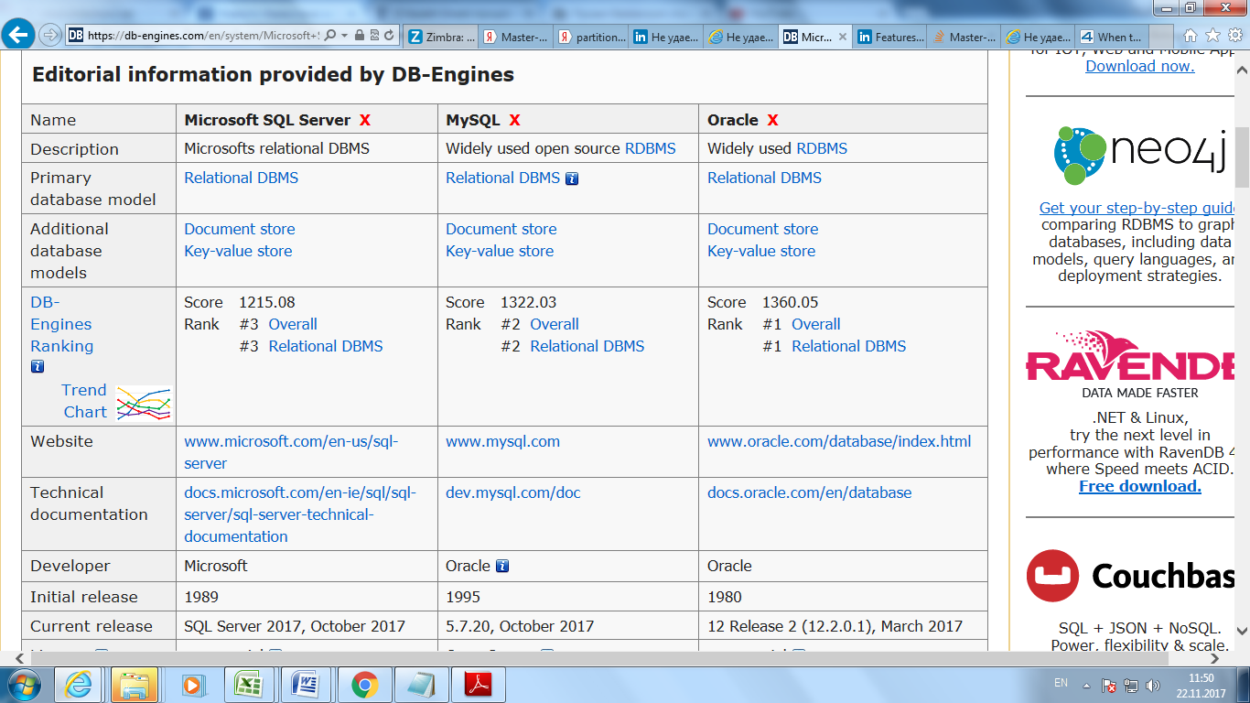
Oracle vs MS SQL comparison

Slide 4
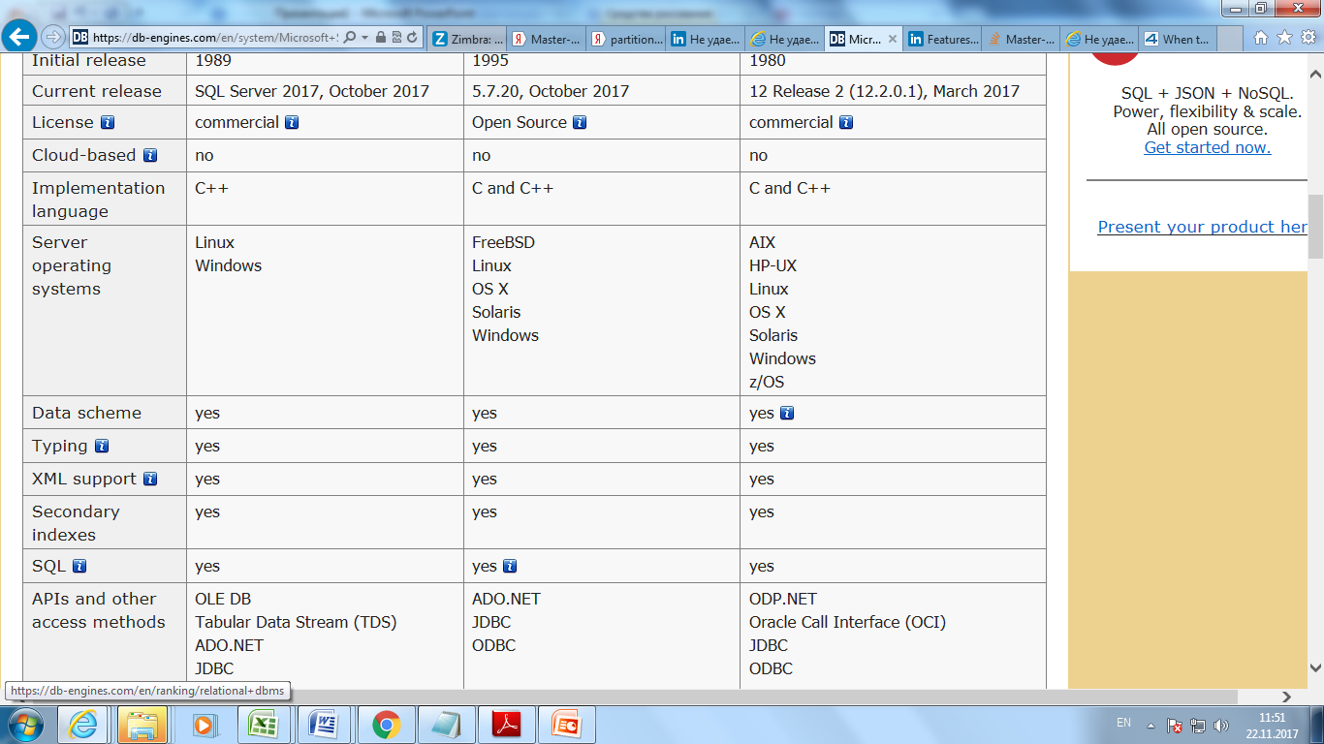
Oracle vs MS SQL comparison

Slide 8
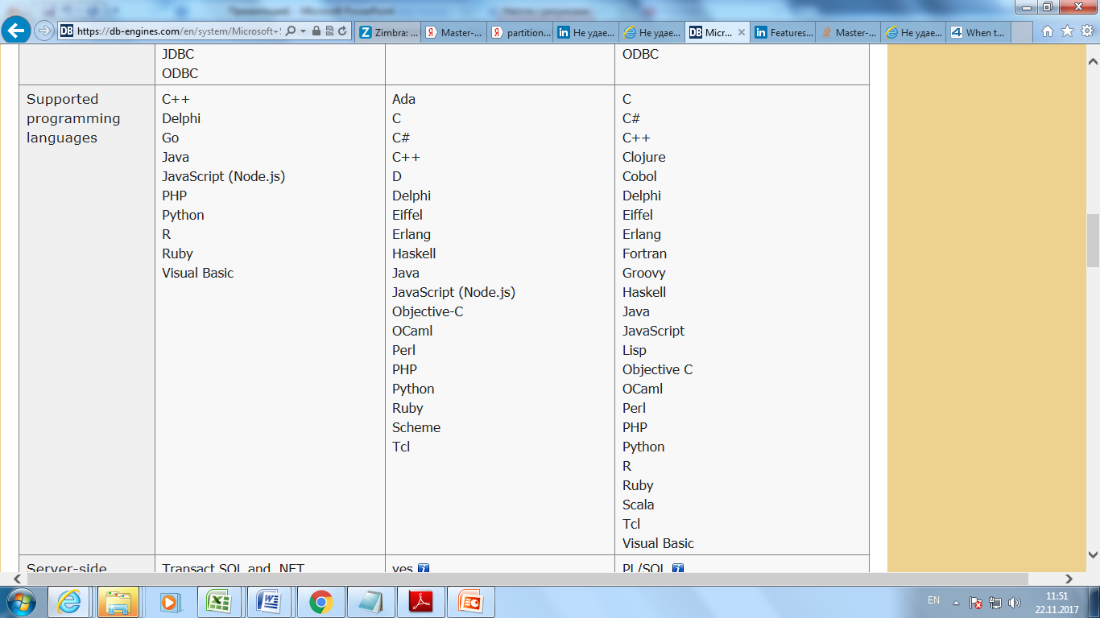
Oracle vs MS SQL comparison

Slide 10
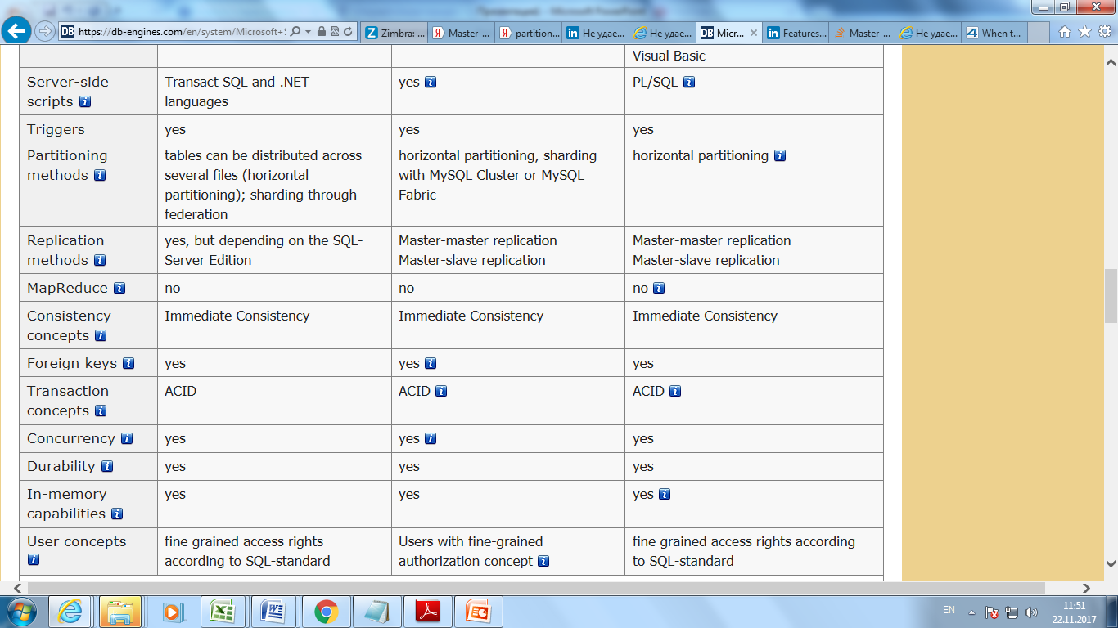
Oracle vs MS SQL comparison

